Slide 1



Lecture Slides
Chapter 16
Clutches, Brakes, Couplings, and Flywheels
© 2015 by McGraw-Hill Education. This is proprietary material solely for authorized instructor use. Not authorized for sale or distribution in any manner. This document may not be copied, scanned, duplicated, forwarded, distributed, or posted on a website, in whole or part.

Slide 2
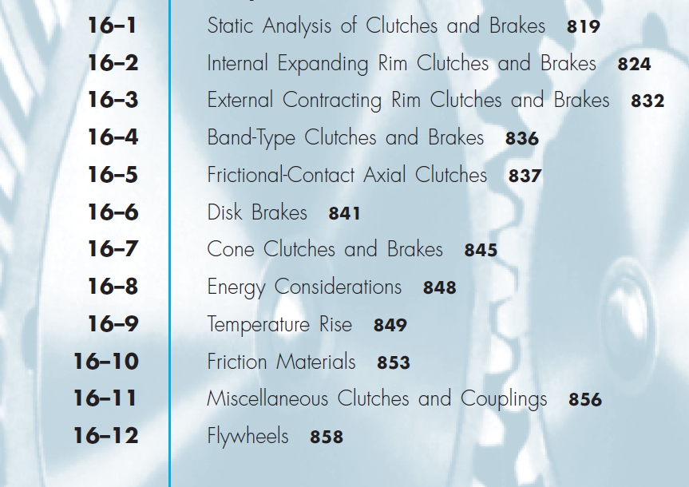
Chapter Outline

Slide 3
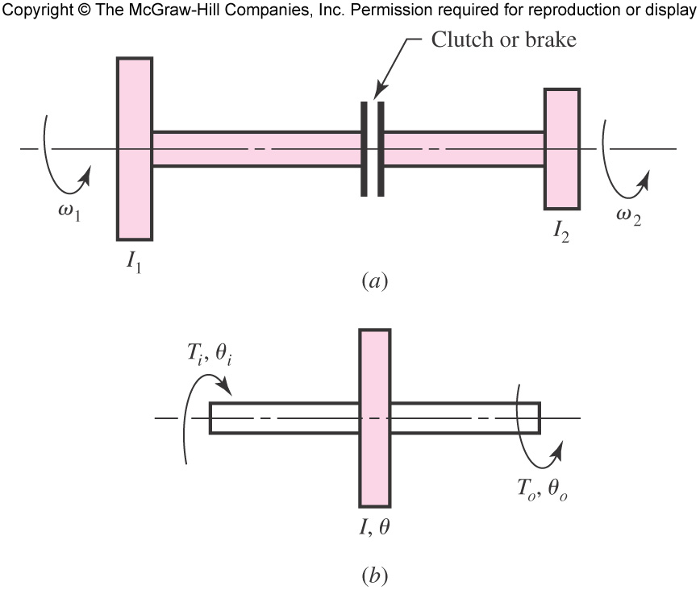
Model of Clutch and Brake
Fig. 16–1

Slide 4
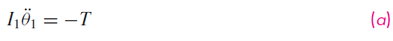
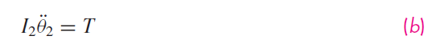
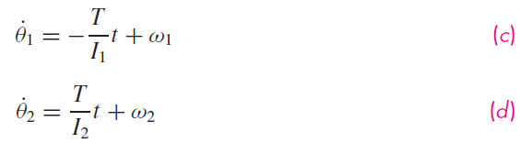
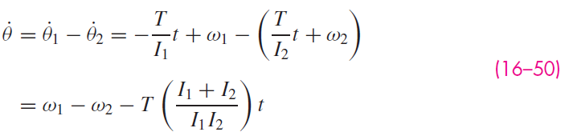
Clutch and Brake from Energy Point of View

Slide 5
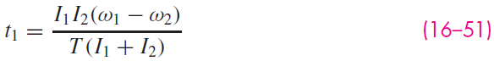
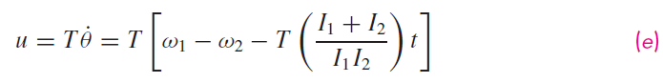
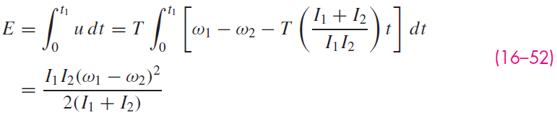
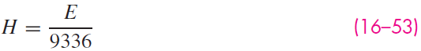
Energy Considerations

Slide 6
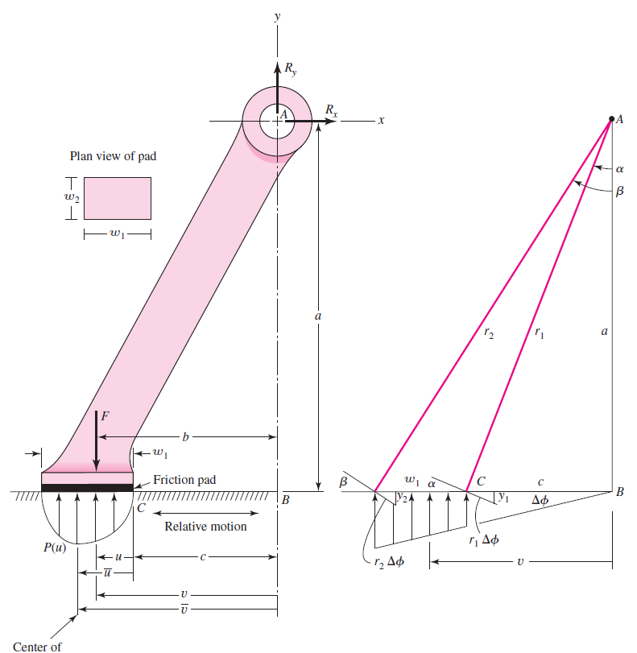
Friction Analysis of a Doorstop
Fig. 16–2

Slide 7
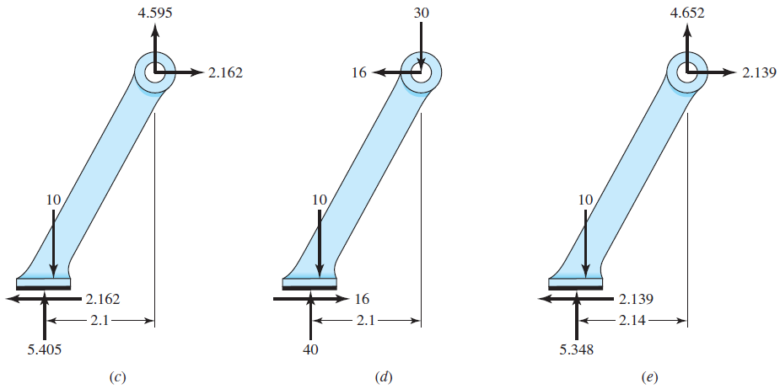
Friction Analysis of a Doorstop
Fig. 16–2

Slide 8
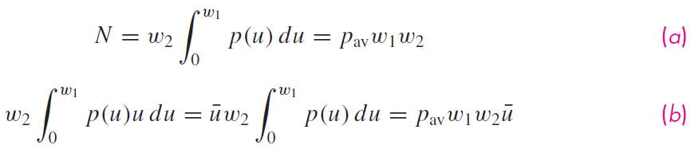
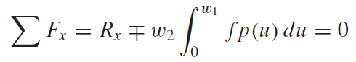
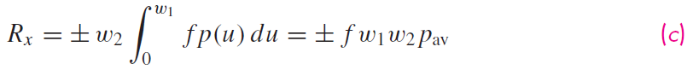
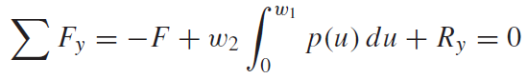
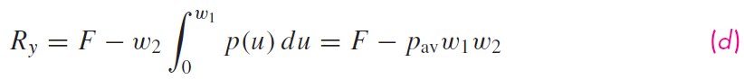
Friction Analysis of a Doorstop

Slide 9
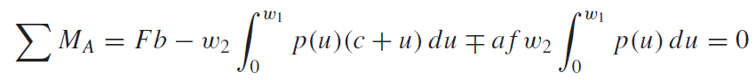
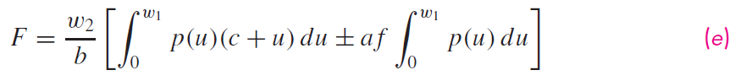
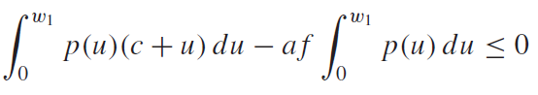
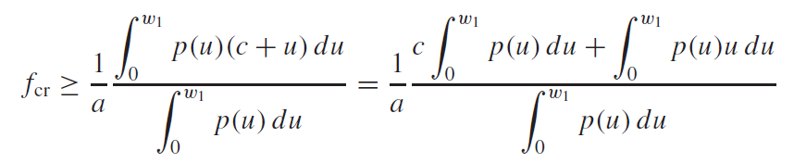
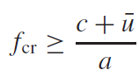
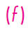
Friction Analysis of a Doorstop

Slide 10
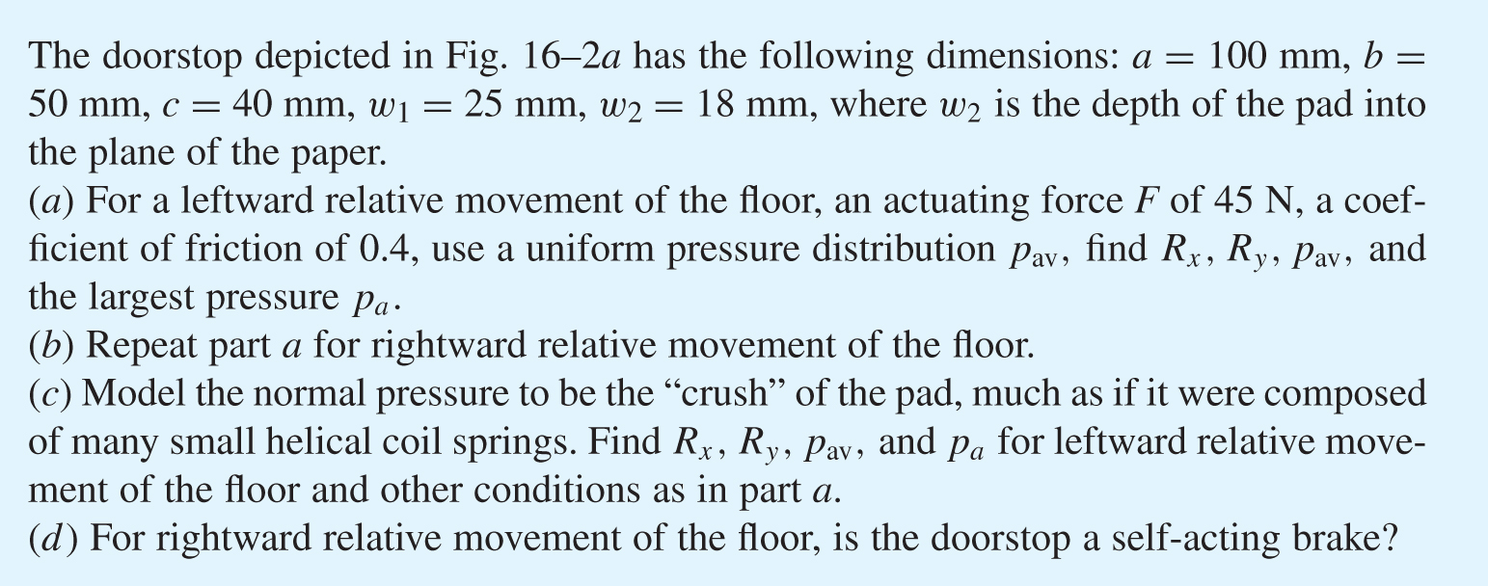
Example 16–1

Slide 11

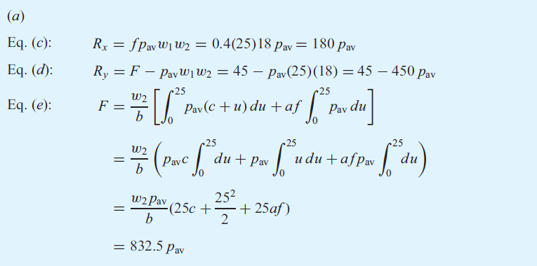
Example 16–1

Slide 12
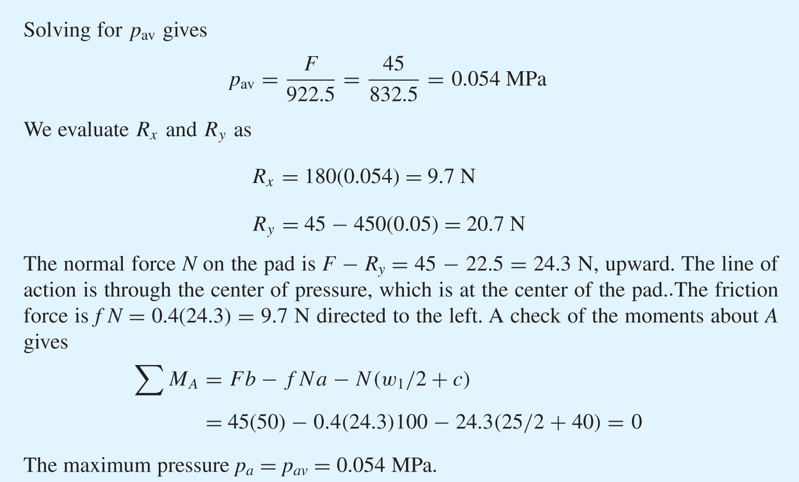
Example 16–1

Slide 13
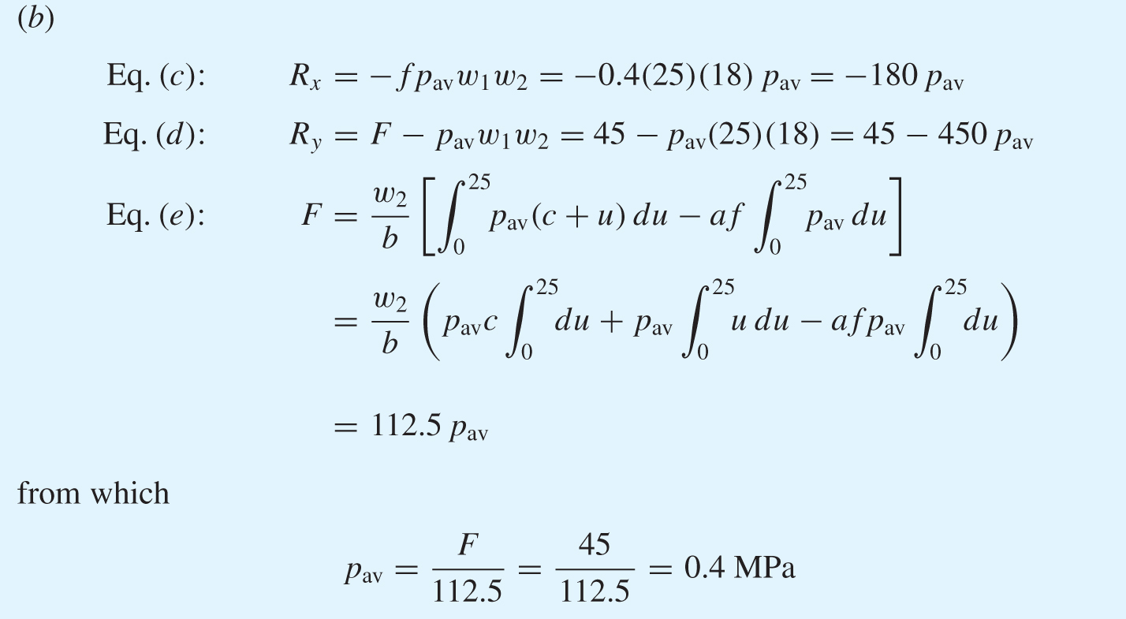
Example 16–1

Slide 14
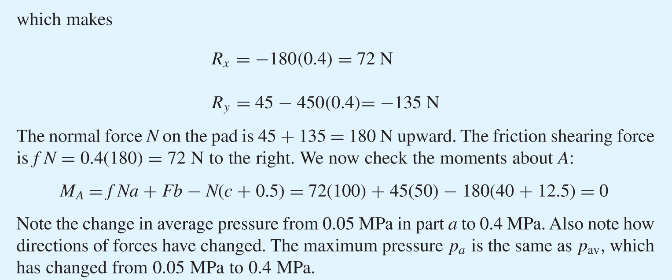
Example 16–1

Slide 15
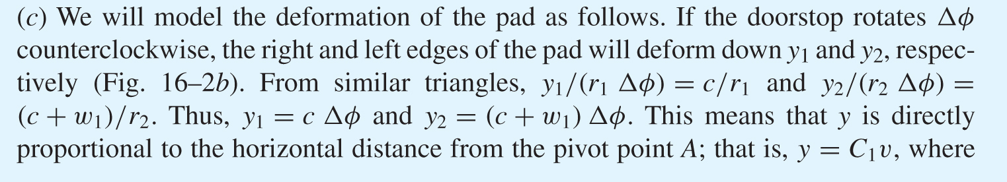
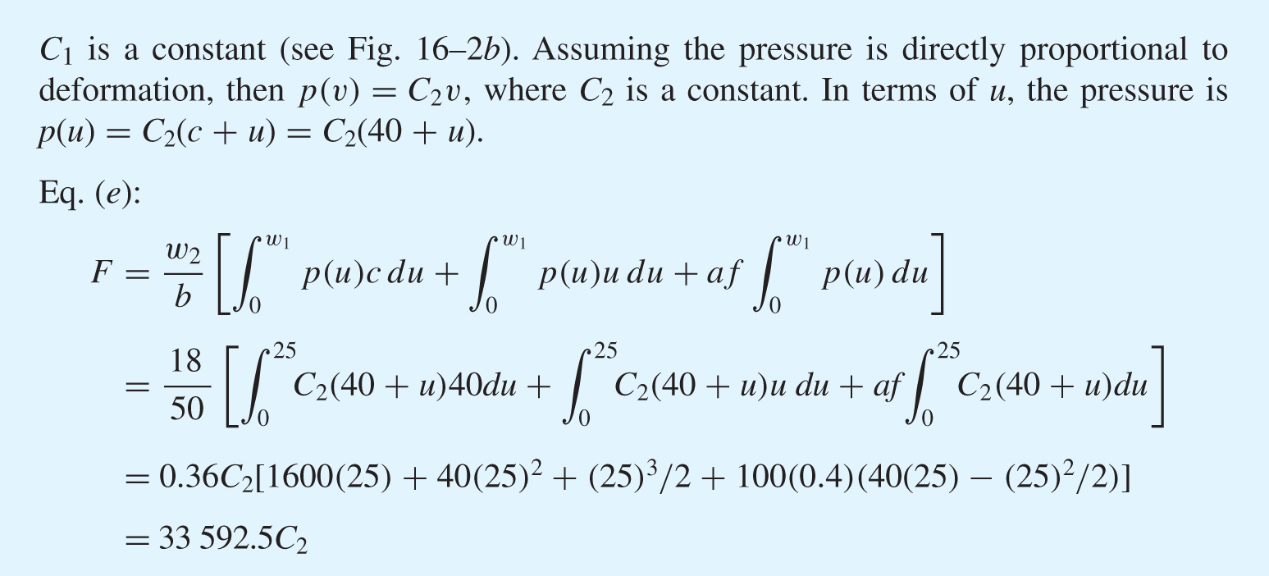
Example 16–1

Slide 16
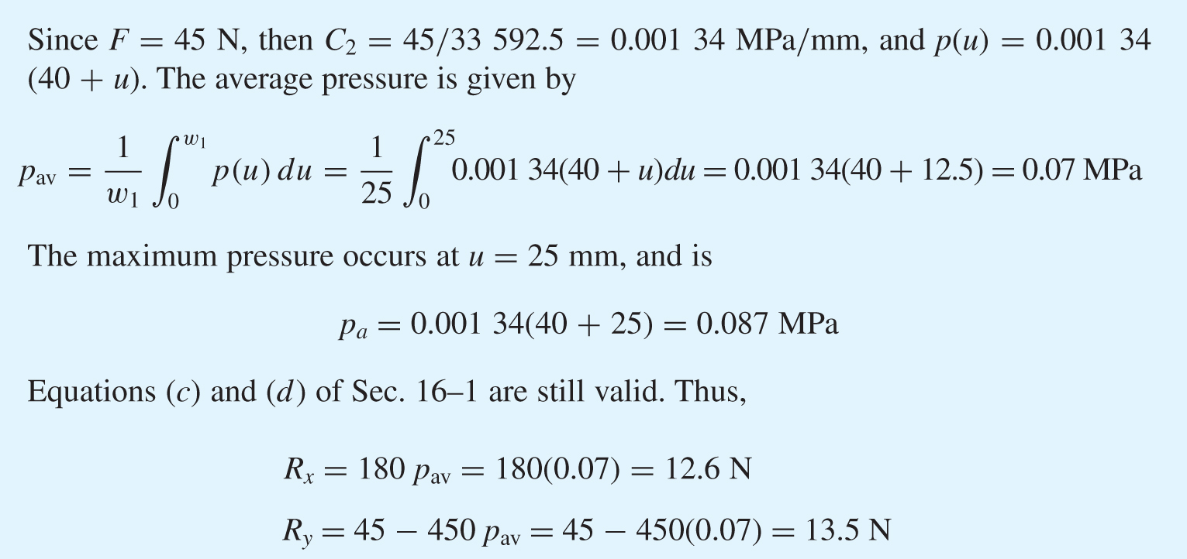
Example 16–1

Slide 17
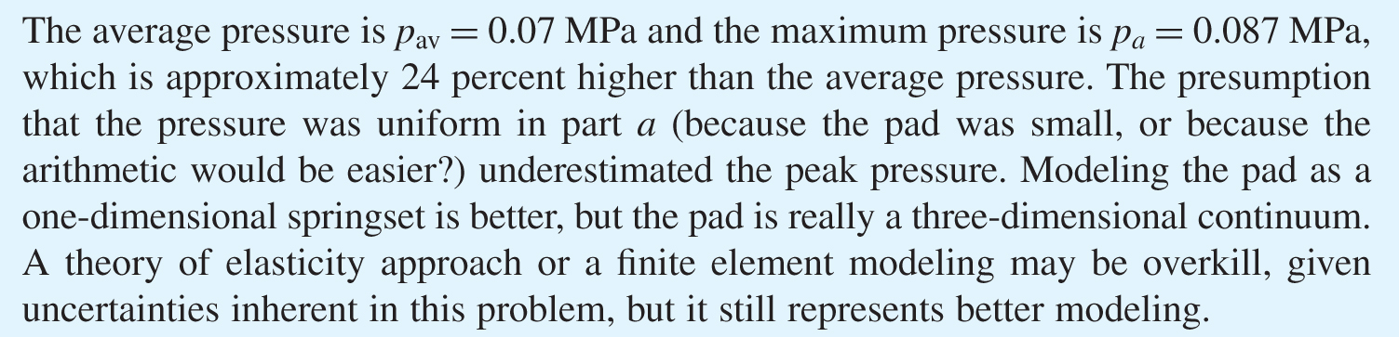
Example 16–1

Slide 18
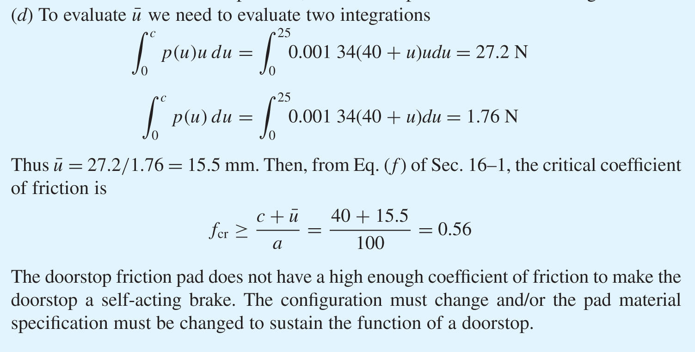
Example 16–1

Slide 19
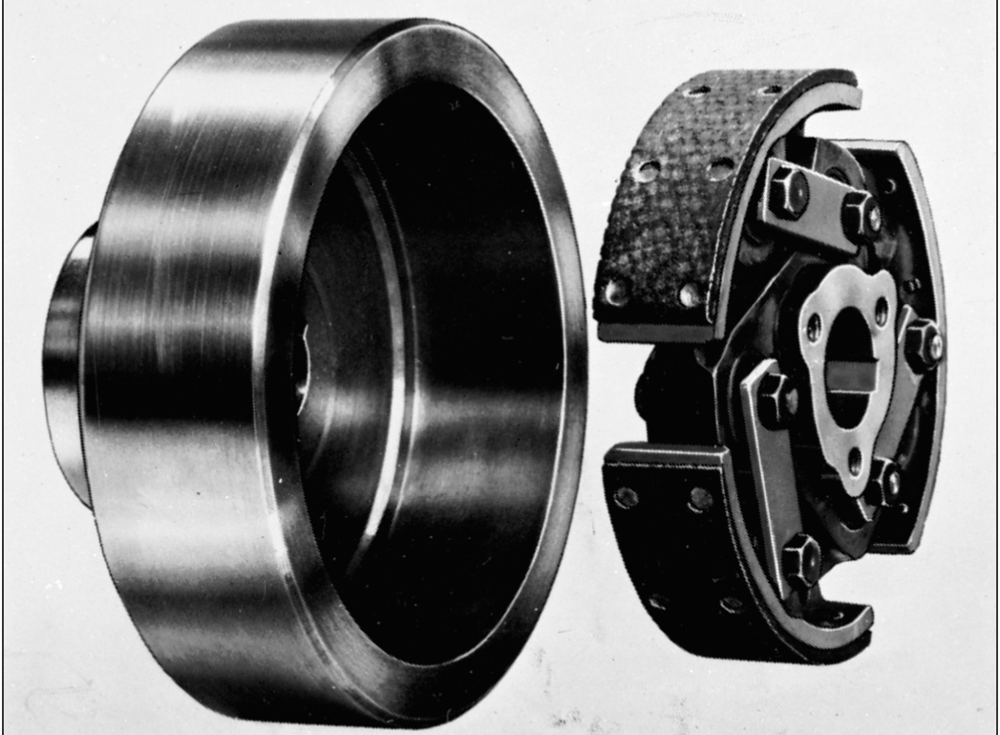
An Internal Expanding Centrifugal-acting Rim Clutch
Fig. 16–3

Slide 20
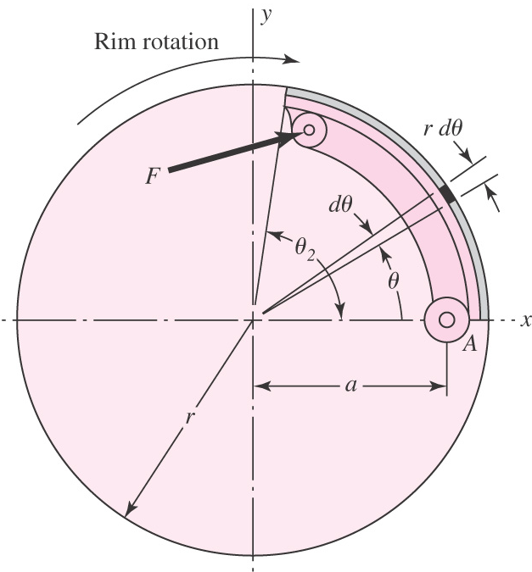
Internal Friction Shoe Geometry
Fig. 16–4

Slide 21
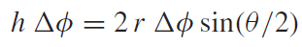
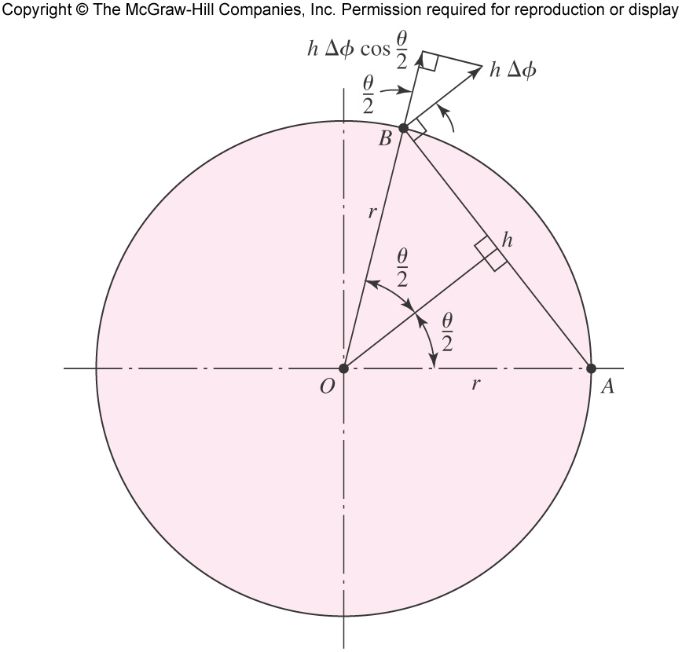
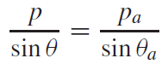
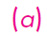
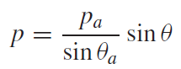
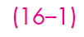
Internal Friction Shoe Geometry
Thus, the deformation, and consequently
the pressure, is proportional to sinθ
Fig. 16–5

Slide 22
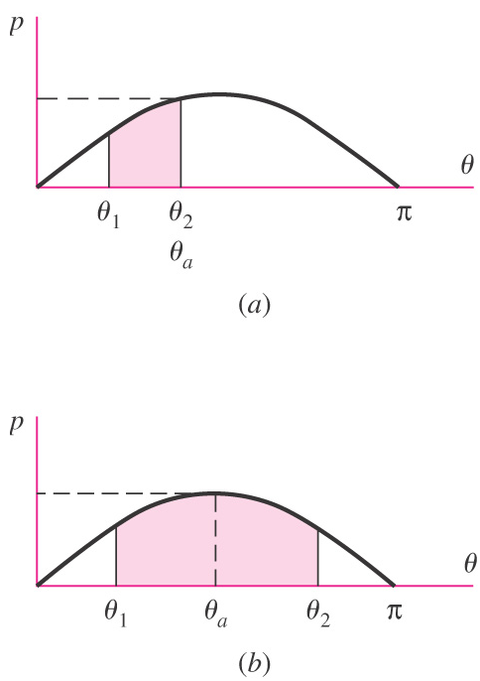
Pressure Distribution Characteristics
Pressure distribution is sinusoidal
For short shoe, as in (a), the largest pressure on the shoe is p_{a} at the end of the shoe
For long shoe, as in (b), the largest pressure is p_{a} at θ_{a} = 90º
Fig. 16–6

Slide 23
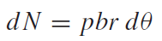
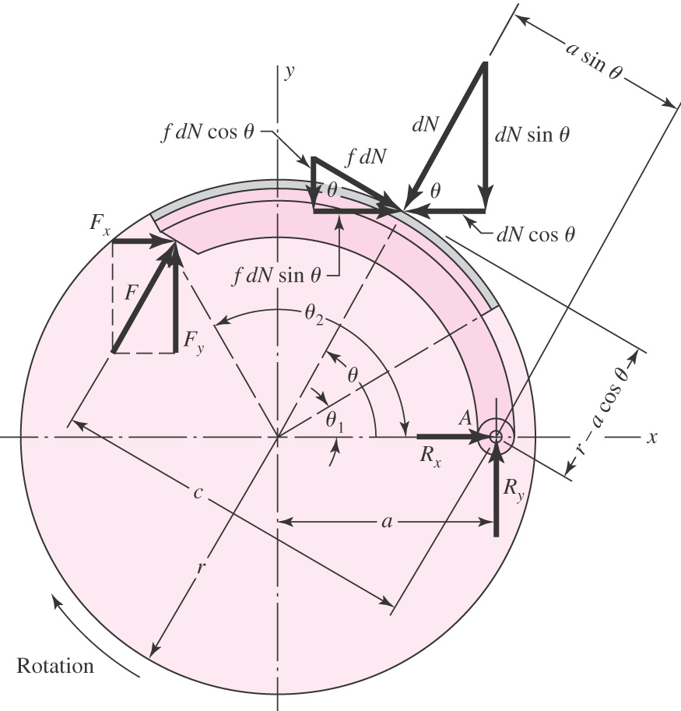
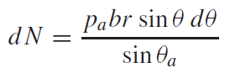
Force Analysis
Fig. 16–7

Slide 24
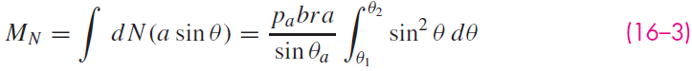
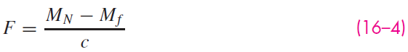
Force Analysis
Actuating force
Self-energizing condition

Slide 25
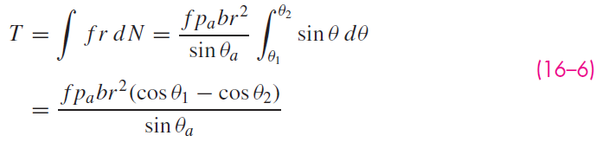
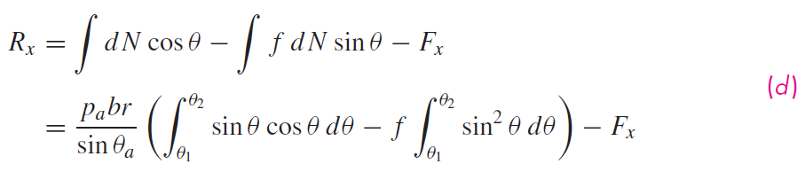
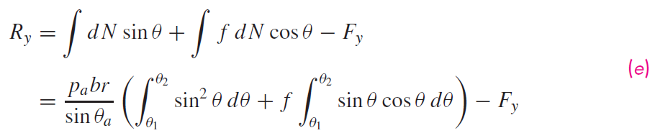
Force Analysis
Braking torque

Slide 26




Force Analysis

Slide 27


Example 16–2
Fig. 16–8

Slide 28


Example 16–2

Slide 29

Example 16–2

Slide 30

Example 16–2

Slide 31


Example 16–2

Slide 32

Example 16–2

Slide 33

Example 16–2

Slide 34

Example 16–2
Fig. 16–9

Slide 35

An External Contracting Clutch-Brake
Fig. 16–10

Slide 36

Notation of External Contracting Shoes
Fig. 16–11

Slide 37




Force Analysis for External Contracting Shoes

Slide 38


Force Analysis for External Contracting Shoes
For counterclockwise rotation:

Slide 39

Brake with Symmetrical Pivoted Shoe
Fig. 16–12

Slide 40






Wear and Pressure with Symmetrical Pivoted Shoe
Fig. 16–12b

Slide 41



Force Analysis with Symmetrical Pivoted Shoe

Slide 42


Force Analysis with Symmetrical Pivoted Shoe

Slide 43

Notation for Band-Type Clutches and Brakes
Fig. 16–13

Slide 44




Force Analysis for Brake Band

Slide 45




Force Analysis for Brake Band

Slide 46

Frictional-Contact Axial Single-Plate Clutch
Fig. 16–14

Slide 47

Frictional-Contact Axial Multi-Plate Clutch
Fig. 16–15

Slide 48

Geometry of Disk Friction Member
Fig. 16–16

Slide 49


Uniform Wear
For uniform wear, w is constant, so PV is constant.
Setting p = P, and V = rω, the maximum pressure p_{a} occurs where r is minimum, r = d/2,

Slide 50



Uniform Wear
Find the total normal force by letting r vary from d/2 to D/2, and integrating,

Slide 51



Uniform Pressure

Slide 52



Comparison of Uniform Wear with Uniform Pressure
Fig. 16–17

Slide 53

Automotive Disk Brake
Fig. 16–18

Slide 54

Geometry of Contact Area of Annular-Pad Brake
Fig. 16–19

Slide 55




Analysis of Annular-Pad Brake

Slide 56


Uniform Wear

Slide 57


Uniform Pressure

Slide 58



Example 16–3

Slide 59

Example 16–3

Slide 60

Example 16–3

Slide 61

Geometry of Circular Pad Caliper Brake
Fig. 16–20

Slide 62

Analysis of Circular Pad Caliper Brake

Slide 63



Example 16–4

Slide 64

Example 16–4

Slide 65

Cone Clutch
Fig. 16–21

Slide 66

Contact Area of Cone Clutch
Fig. 16–22

Slide 67




Uniform Wear

Slide 68

Uniform Pressure

Slide 69
Energy Considerations

Slide 70
Energy Considerations

Slide 71


Temperature Rise

Slide 72

Newton’s Cooling Model

Slide 73

Effect of Braking on Temperature
Fig. 16–23

Slide 74

Rate of Heat Transfer

Slide 75

Heat-Transfer Coefficient in Still Air
Fig. 16–24a

Slide 76

Ventilation Factors
Fig. 16–24b

Slide 77




Energy Analysis

Slide 78



Example 16–5

Slide 79

Example 16–5

Slide 80

Example 16–5

Slide 81

Area of Friction Material for Average Braking Power

Slide 82

Characteristics of Friction Materials
Table 16–3

Slide 83

Some Properties of Brake Linings
Table 16–4

Slide 84

Friction Materials for Clutches

Slide 85

Positive-Contact Clutches
Characteristics of positive-contact clutches
No slip
No heat generated
Cannot be engaged at high speeds
Sometimes cannot be engaged when both shafts are at rest
Engagement is accompanied by shock
Square-jaw Clutch
Fig. 16–25a

Slide 86

Overload Release Clutch
Fig. 16–25b

Slide 87


Shaft Couplings
Fig. 16–26

Slide 88


Flywheels

Slide 89

Hypothetical Flywheel Case
Fig. 16–27

Slide 90



Kinetic Energy

Slide 91

Engine Torque for One Cylinder Cycle
As engine torque fluctuates, a flywheel is needed for smooth out speed.
Fig. 16–28

Slide 92


Coefficient of Speed Fluctuation, C_{s}

Slide 93


Energy Change

Slide 94


Example 16–6

Slide 95

Example 16–6
Table 16–6

Slide 96

Example 16–6

Slide 97

Punch-Press Torque Demand
Fig. 16–29

Slide 98





Punch-Press Analysis

Slide 99


Induction Motor Characteristics
$$T_{M}=aω+b$$

Slide 100





Induction Motor Characteristics
Acceleration:
$$I\ddot{θ=T_{M} (i.e.,\frac{Idω}{dt}=T_{M})}$$
Deceleration:

Slide 101


Induction Motor Characteristics

Slide 102


Slide 104

Fig 9-21

Slide 105


Slide 107

Fig 9-22

Slide 108


Slide 110


Slide 111


